Slide 1
Type 1 Diabetes
By Desiree Fremer, RN

Slide 2
Normally….
When we eat, insulin is released by the pancreas to convert carbohydrates to energy. The natural insulin acts quickly, so our blood sugar does not go too high. When we exercise, glucagon is released by the pancreas to keep our blood sugar from going too low.
Blood sugar
BALANCE OF TWO CYCLES = STABLE/NORMAL
BLOOD SUGARS
Blood sugar

Slide 3
In Type 1 Diabetes….
The pancreas does not produce insulin, so carbohydrates can not be converted into energy. The blood sugar goes too high.
Blood sugar

Slide 4
In type 1 diabetes, the pancreas does not produce glucagon, so low blood sugar with exercise/activity, can not be prevented naturally. Blood sugar goes too low.
Blood sugar

Slide 5
Cause of type 1 diabetes
Type 1 diabetes is caused by an autoimmune response, in which, a virus causes the immune system to attack the cells in the pancreas. The attacked cells are the cells responsible for producing insulin and glucagon.
It can not be prevented, and has nothing to do with diet and exercise prior to diagnosis.
It is believed to have a genetic component.
It has no cure, just constant management with blood sugar monitoring, diet management, and insulin administration
Can be life threatening if managed poorly
Is lifelong, all day, every day management.

Slide 6
Managing diabetes consists of…
Monitoring blood sugar levels, by either fingerstick or continuous glucose monitor
Injecting insulin with multiple daily shots or through an insulin pump
Having access to fast acting carbohydrates (juice, fruit snacks, candy, glucose tabs) at all times, in case of falling blood sugars
Keeping a glucagon injection readily available at all times, in case of dangerously low blood sugar, leading to unconsciousness
Family, friends, classsmates, and school staff that have knowledge to help/get help in case of an emergency.

Slide 7
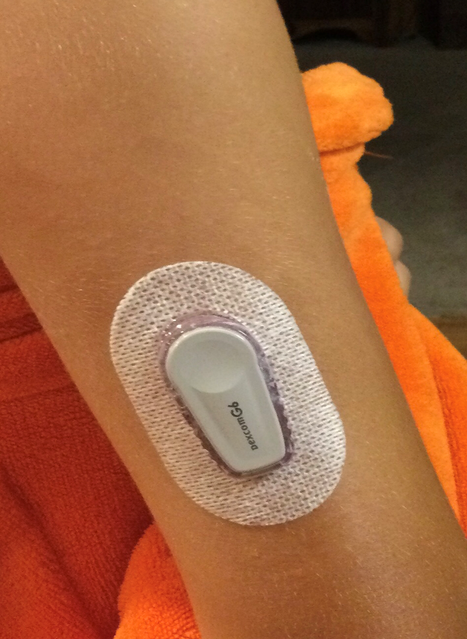
Monitoring blood sugar
A glucometer is used to check blood sugar four or more times a day. Blood is collected by using a small needle to prick the tip of the finger, and a drop of blood is placed on the meter strip.
A continuous glucose monitor, such as a dexcom, can be used to have blood sugar readings available at all times. Readings are sent to a receiver or smartphone. Blood sugar readings can also be sent to others, (family members/healthcare providers) so they are aware of highs and lows.

Slide 8
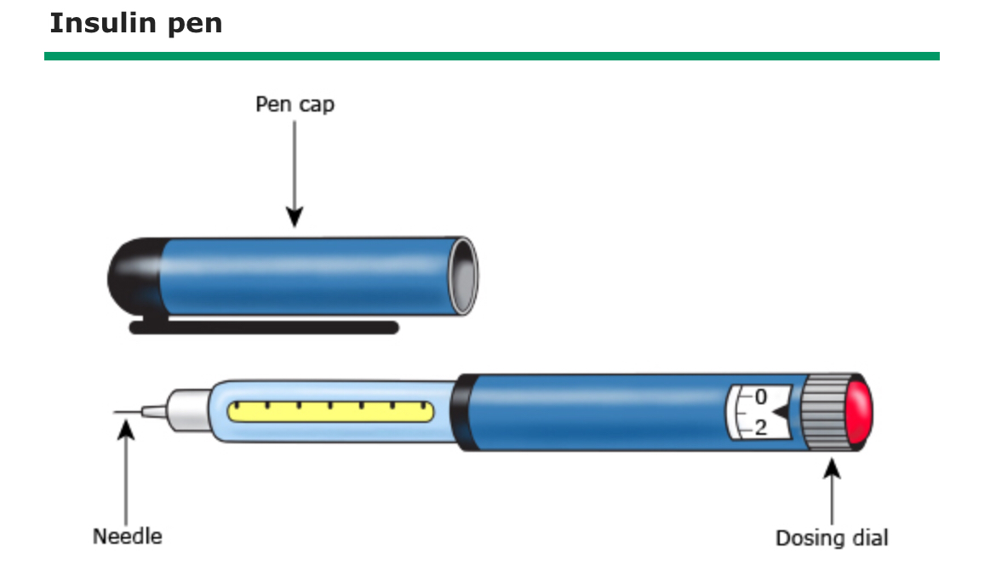
Giving insulin shots
Insulin shots can be given by drawing insulin from a vial into a syringe, or by using an insulin pen, which contains a vial of insulin. The required insulin dose is dialed in on the pen before administering the shot.

Slide 9
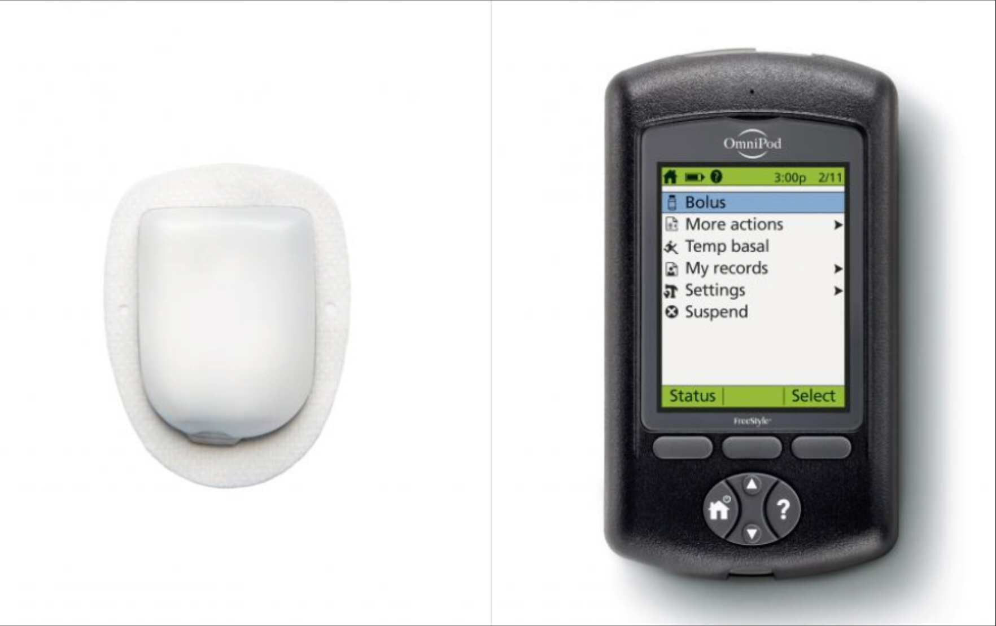
Insulin pumps (like an external pancreas)
Insulin can be given through a pump, which is connected to you at all times. With a tubeless system, the pod is filled with insulin and applied to the skin, and a small plastic tube is injected under the skin. Using radio frequency, the PDM communicates insulin doses and rate changes to the pod.
Systems that are not tubeless include a small infusion set that is applied to the skin. A small plastic tube is injected under the skin. The infusion set is connected to the pump by a thin, clear, flexible tube. The pump, which is battery operated, holds the insulin, and is used to make rate changes and give insulin boluses.

Slide 10
Hyperglycemia (high blood sugar) caused by:
Not using enough insulin
Miscounting carbohydrates
Not injecting insulin properly or using expired insulin
Eating certain carbs
Being inactive
Having an illness or infection
Using certain medications, such as steroids
Being injured or having surgery
Experiencing emotional stress
Hormones

Slide 11
Symptoms of high blood sugar

Slide 12
Long term consequences of high blood sugars
Cardiovascular (heart) disease
Nerve damage
Kidney damage or kidney failure
Damage to the blood vessels of the retina, potentially leading to blindness
Clouding of the normally clear lens of your eye
Problems caused by damaged nerves or poor blood flow that can lead to serious skin infections, ulcerations, and in some severe cases, amputation
Bone and joint problems
Teeth and gum infections

Slide 13
Emergency complication of high blood sugar
Diabetic ketoacidosis. Diabetic ketoacidosis develops when you don't have enough insulin in your body. When this happens, sugar (glucose) can't enter your cells for energy. Your blood sugar level rises, and your body begins to break down fat for energy.
This process produces toxic acids known as ketones. Excess ketones accumulate in the blood and eventually "spill over" into the urine. Left untreated, diabetic ketoacidosis can lead to a diabetic coma and be life-threatening.

Slide 14
Hypoglycemia (low blood sugar ) caused by:
Taking too much insulin
Miscounting carbohydrates
Not eating enough
Postponing or skipping a meal or snack
Increasing exercise or physical activity without eating more or adjusting your medications
Drinking alcohol

Slide 15
Symptoms of low blood sugar

Slide 16
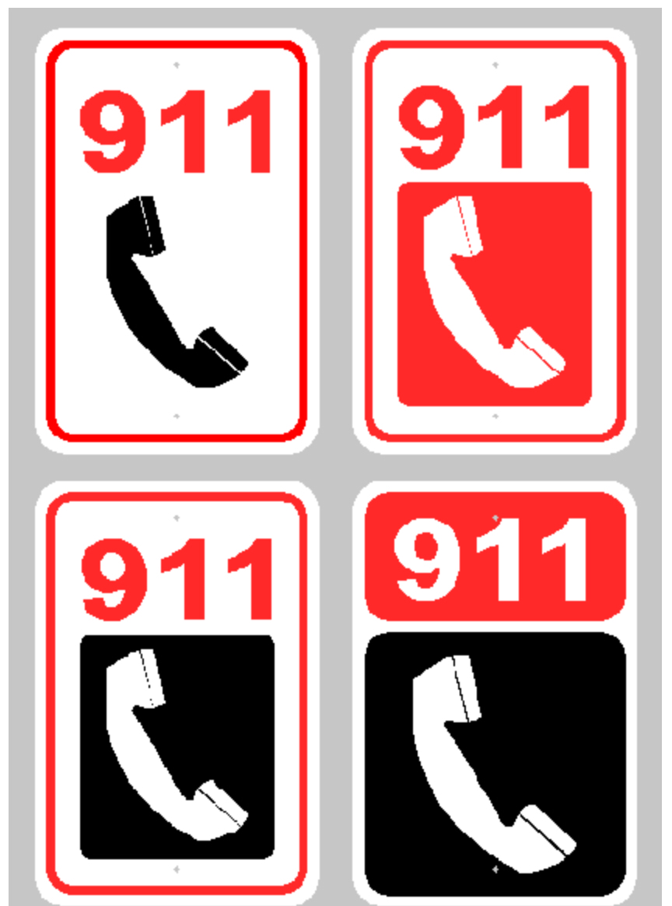
Extreme low blood sugar can cause
Seizures
Loss of consciousness
Death

Slide 17
Exercise and blood sugar
Can be very difficult to maintain stable blood sugars with exercise
Exercise can cause rapid drops in blood sugars, especially if an insulin bolus has been given within the last 3 hours. Insulin stays active for up to 3 hours, and has an increased effect with activity.
Exercise can cause increased blood sugars, due to endorphin release.
Starting with already high blood sugar can cause ketones to be produced during exercise.
Starting with already low blood sugar makes it extremely difficult to maintain a high enough blood sugar to safely exercise.

Slide 18
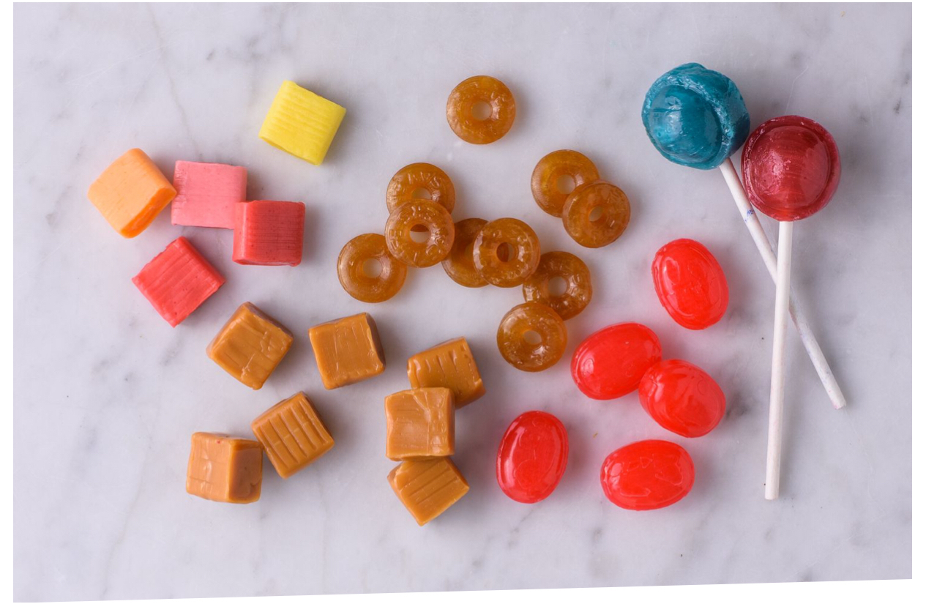
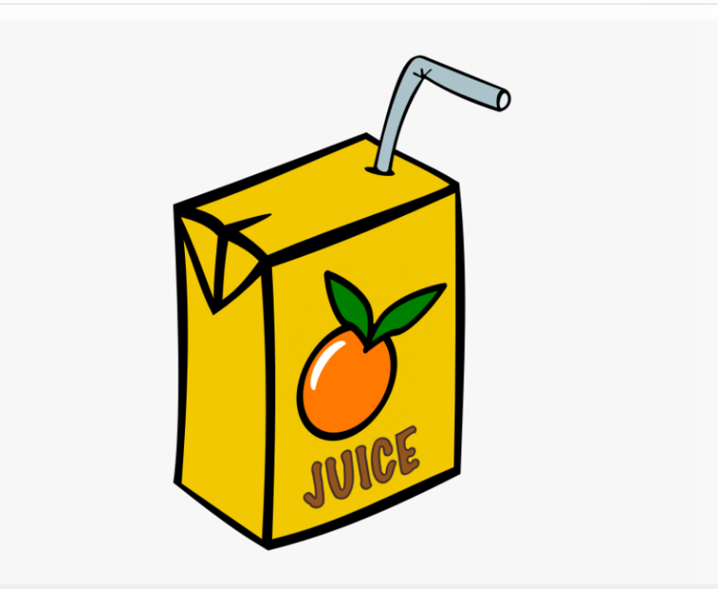
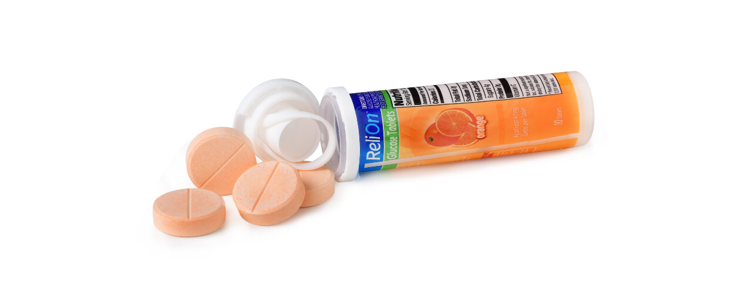
Treating low blood sugar
Fast acting carbohydrates/simple sugars-brings blood sugar up quickly
Examples: juice, candy, fruit snacks, glucose tablets
If low blood sugar occurs during activity, STOP activity, eat/drink 15 grams of FAST ACTING carbs, and sit until blood sugar increases
Should not be left alone with low blood sugar

Slide 19
Low blood sugar causing loss of consciousness
EMERGENCY!!!!!
GIVE GLUCAGON INJECTION AND TURN PERSON ON THEIR SIDE (They will throw up)
CALL 911
DO NOT LEAVE PERSON ALONE

Slide 20
Giving glucagon G-voke

Slide 21
What you should know
People with diabetes can do everything people without diabetes can do, but it takes a lot more planning and attention to their body and health.
Type 1 diabetes is so much different from Type 2 diabetes, that a lot of older family members may have.
People with diabetes are at a much higher risk for further health problems if they manage their blood sugars poorly.
People with diabetes are constantly facing decisions that affect their health.
There are no two days alike, when caring for diabetes.
Most people with diabetes are happy to answer any questions you may have about their diabetes care/management.

